Slide 1
SSA and EU free trade agreement - A sectoral analysis using GTAP model
Anuj Chauhan

Slide 2
Problem statement
FTA or trade liberalisation should benefit SSA and EU (theoretically)
Objective
To test the impact of FTA on different sectors of economy in SSA and EU

Slide 3
Flow
Introduction to CGE
Simulation scenario - aggregation scheme
Shocks to simulate FTA
Immediate effects of FTA - Prices and Demand in EU and SSA
Effects on Endowment rates - Land, Labour, Capital
Effects on Imports and Exports
Trade Balance
Effects on TOT
Change in the GDP
Change in the Allocative Efficiency
Effect on Welfare - employment, tot, allocative efficiency.

Slide 4
Simulation Scenario
Aggregation of countries into 3 regions
Aggregation of different sectors into 3 sectors
Shocks to simulate Free Trade Agreement

Slide 5
Aggregation of countries into 3 regions
SSA (Sub-Saharan Africa, inclusive of South Africa)
Angola, Benin, Botswana, Burkina Faso, Burundi, Cameroon, Cape Verde, Central African Republic, Chad, Comoros, Congo (Brazzaville), Congo (Democratic Republic), Djibouti, Equatorial Guinea, Eritrea, Ethiopia, Gabon, The Gambia, Ghana, Guinea, Guinea-Bissau, Kenya, Lesotho, Liberia, Madagascar, Malawi, Mali, Mauritania, Mauritius, Mozambique, Namibia, Niger, Nigeria, Réunion, Rwanda, Sao Tome and Principe, Senegal, Seychelles, Sierra Leone, Somalia, South Africa, Sudan, Swaziland, Tanzania, Togo, Uganda, Western Sahara, Zambia, Zimbabwe.

Slide 6
EU (European Union)
Austria, Italy, Belgium, Latvia, Bulgaria, Lithuania, Croatia, Luxembourg, Cyprus, Malta, Czech Republic, Netherlands, Denmark, Poland, Estonia, Portugal, Finland, Romania, France, Slovakia, Germany, Slovenia, Greece, Spain, Hungary, Sweden, Ireland, United Kingdom.
ROW (Rest of the World)
Countries except EU and SSA

Slide 7
Aggregation of P/S into 3 sectors
Food (food and agriculture)
Paddy rice, Wheat, Cereal grains, Vegetables, fruit, nuts, Oil seeds, Sugar cane, sugar beet, Plant-based fibers, Crops nec, Bovine cattle, sheep and goats, horses, Animal products, Raw milk Wool silk-worm cocoons, Bovine cattle, sheep and goat, horse meat prods, Meat products nec, Vegetable oils and fats, Dairy products, Processed rice, Sugar, Food products nec, Beverages and tobacco products

Slide 8
3X3 aggregated database
Mnfcs (resources and manufactures)
Forestry, Fishing, Coal, Oil, Gas, Minerals nec, Textiles, Wearing apparel, Leather products, Wood products, Paper products, publishing, Petroleum, coal products, Chemical, rubber, plastic products, Mineral products nec, Ferrous metals, Metals nec, Metal products, Motor vehicles and parts, Transport equipment nec, Electronic equipment, Machinery and equipment nec, Manufactures nec
Svces (all services)
Electricity, Gas manufacture, distribution, Water, Construction Trade, transport, Financial, business, recreational services, Public admin and defence, education, health, Dwellings & Svces

Slide 9
Shocks to Pre-Liberalisation scenario
4 shocks have been given to simulate Free trade agreement
1) Elimination of tariffs by EU on imports from SSA on all sectors
Shock tms(TRAD_COMM,"SSA","EU") = select from file tms.shk ;
2) Elimination of export subsidies by EU on export to SSA on all sectors
Shock txs(TRAD_COMM,"EU","SSA") = select from file txs.shk;

Slide 10
3) Elimination of tariffs by SSA on imports from EU on all sectors
Shock tms(TRAD_COMM,"EU","SSA") = select from file tms.shk;
4) Elimination of export subsidies by SSA on export to EUon all sectors
Shock txs(TRAD_COMM,"SSA","EU") = select from file txs.shk;

Slide 11
Immediate effects (after simulation)
Prices
Due to elimination of mutual import tariff and export subsidies the prices of all sectors in both EU and SSA will be affected immediately.
Demand
Due to the change in the prices of commodities in the markets of EU and SSA, the demand of all commodities will be affected.

Slide 12
Price index of Imports in the EU
pfm[**EU] is the price index of different sectors products used by different sectors in EU
pfm[**EU] | Food | Mnfcs | Svces | CGDS
Food | -0.86 | -0.86 | -0.86 | -0.86
Mnfcs | -0.1 | -0.1 | -0.1 | -0.1
Svces | -0.05 | -0.05 | -0.05 | -0.05
We can see that prices of all the products and services used by different sectors has gone down in EU

Slide 13
Demand of Imports in the EU
qfm[**EU] : is the demand of different sector products used by different sectors in EU
qfm[**EU] | Food | Mnfcs | Svces | CGDS
Food | 0.27 | 0.88 | 1.32 | 0.51
Mnfcs | -0.91 | 0.17 | 0.03 | 0
Svces | -1 | 0.09 | -0.06 | -0.08
We can see that demand of all the products and services used by different sectors has gone up in the EU but for some sectors it has gone down.

Slide 14
Price index of Imports in the SSA
pfm[**SSA] : is the % change in the price index of different sectors products used by different sectors in SSA
pfm[**SSA] | Food | Mnfcs | Svces | CGDS
Food | 8.81 | 8.81 | 8.81 | 8.81
Mnfcs | -1.11 | -1.11 | -1.11 | -1.11
Svces | -0.36 | -0.36 | -0.36 | -0.36
We can see that prices of all the products and services used by different sectors has gone down in SSA but the prices of Food sector has gone drastically up.

Slide 15
Demand of Imports in the SSA
qfm[**SSA] : is the % chang in demand of different sector products used by different sectors in SSA
qfm[**SSA] | Food | Mnfcs | Svces | CGDS
Food | -0.11 | -9.93 | -7.9 | -7.28
Mnfcs | 15.21 | 4.1 | 6.77 | 5.43
Svces | 14.69 | 2.96 | 5.49 | 7.27
We can see that demand of all the products and services used by different sectors has gone up in the EU but for some sectors it has gone down.

Slide 16
Effect on the Endowment demand by EU
qfe[**EU] : is the demand of endowments in EU due to change in the demand of imports by SSA
qfe[**EU] | Food | Mnfcs | Svces | CGDS
Land | 0 | 0.95 | 0.96 | 0.81
UnskLab | -0.97 | 0.18 | 0.04 | 0
SkLab | -0.99 | 0.14 | -0.01 | -0.03
Capital | -0.97 | 0.18 | 0.03 | -0.01
NatRes | 0 | 0 | 0 | 0
Import demand of food by SSA gone down => demand for endowments gone down Import demand of other P/S by SSA gone up => demand for endowments gone up in the Markets of EU
So it is concluded that employment would be generated in Mnfcs and Svces sector but there will be unemployment in Food sector

Slide 17
Effect on Endowment demand by SSA
qfe[**SSA] : is the demand of endowments in SSA due to change in the demand of imports by SSA
qfe[**SSA] | Food | Mnfcs | Svces | CGDS
Land | 0 | -9.46 | -8.56 | -6.97
UnskLab | 8.36 | -5.89 | -2.87 | -1.16
SkLab | 9.78 | -3.52 | 0.11 | 1
Capital | 9.64 | -3.77 | -0.2 | 0.78
NatRes | 0.02 | 0 | 0 | 0
Import demand of food by SSA gone down => less imports from EU => Domestic demand of food by SSA gone up => demand for endowments gone up in the food markets of SSA and vice-versa in Mnfcs and Svces.
So it can be concluded that there will be employment generation in the Food sector in SSA and unemployment in the other sectors

Slide 18
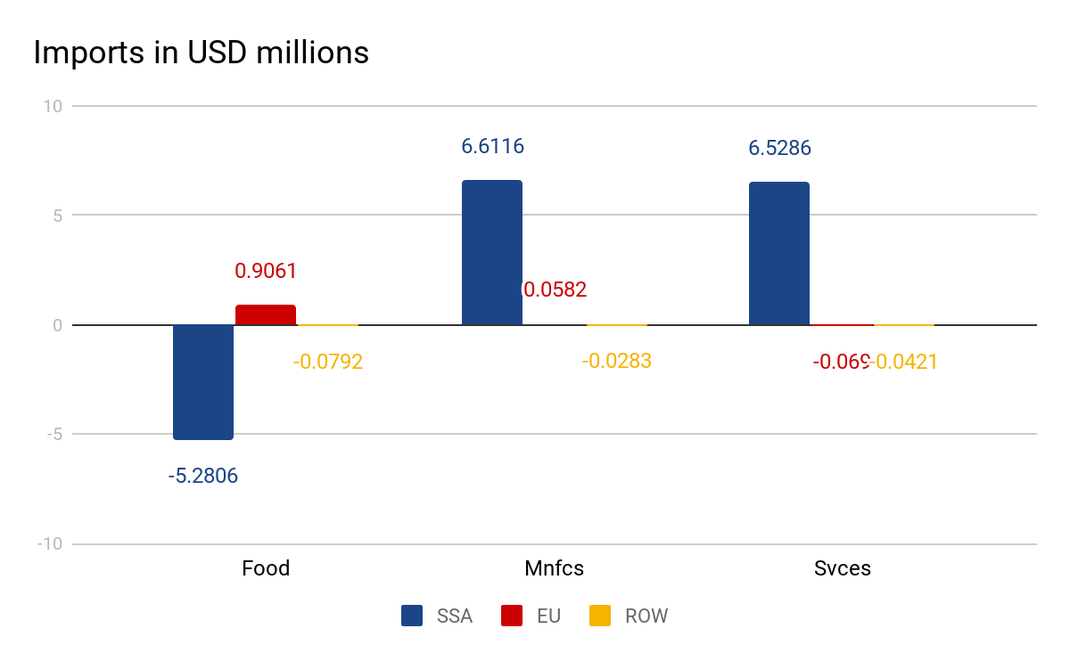
Effect on Imports
Food import demand gone down => food imports decreases in SSA and vice versa for other sectors,
imports demand of food in EU gone up => imports of EU gone up and similar for other sectors
qim | SSA | EU | ROW
Food | -5.2806 | 0.9061 | -0.0792
Mnfcs | 6.6116 | 0.0582 | -0.0283
Svces | 6.5286 | -0.069 | -0.0421

Slide 19
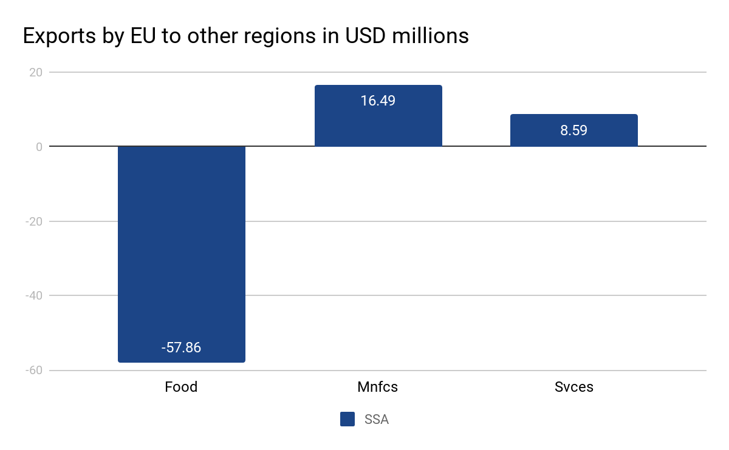
Effect on Exports by EU
Food import demand gone down => food export by EU to SSA decreases.
qxs[*EU*] | SSA
Food | -57.86
Mnfcs | 16.49
Svces | 8.59

Slide 20
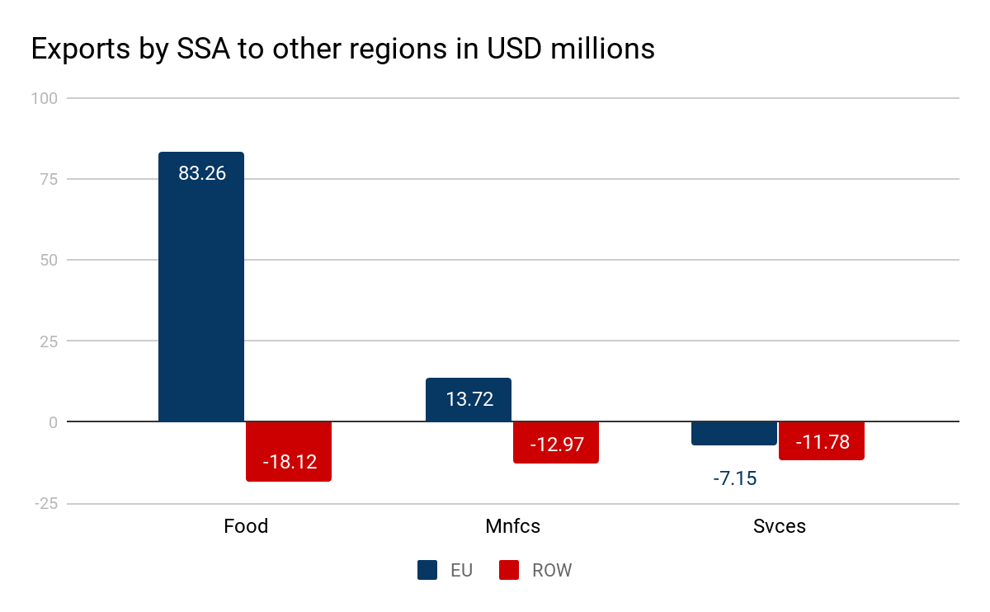
Effect on Exports by SSA
qxs[*SSA*] | EU | ROW
Food | 83.26 | -18.12
Mnfcs | 13.72 | -12.97
Svces | -7.15 | -11.78
Food import demand gone up in EU => food export by SSA increases and vice versa for other sectors.
Trade diversion from ROW to EU

Slide 21
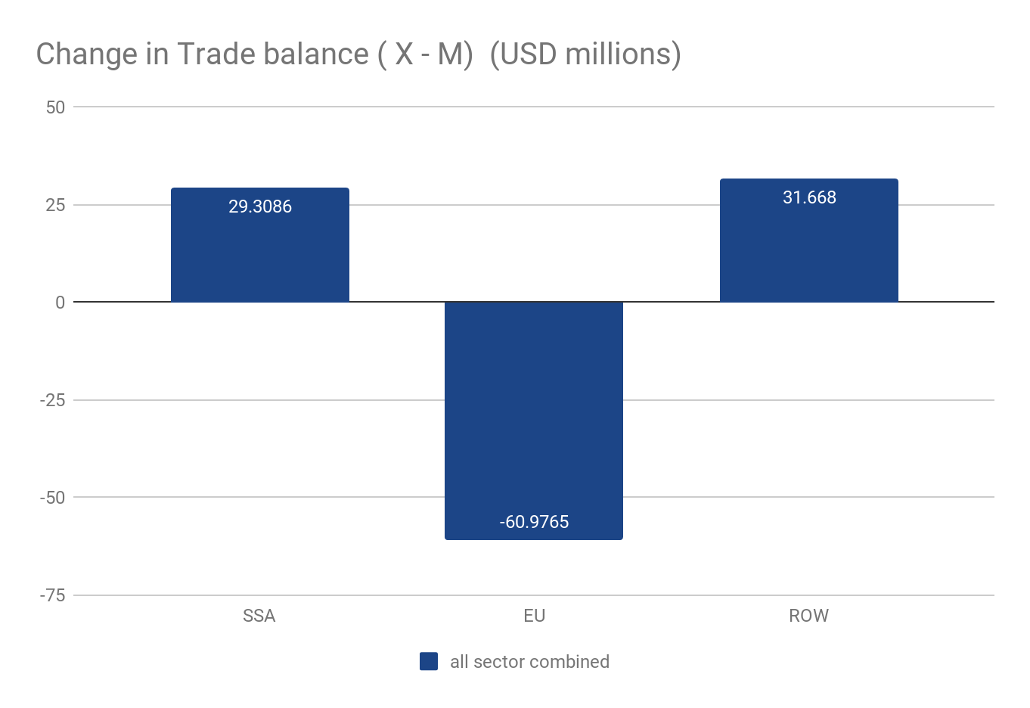
Effect on Trade Balance
DTBAL | (Sim)
SSA | 29.3086
EU | -60.9765
ROW | 31.668
The combined exports and imports of all sectors are shown here and it is concluded that EU would have a negative trade balance and SSA would have a positive trade balance

Slide 22
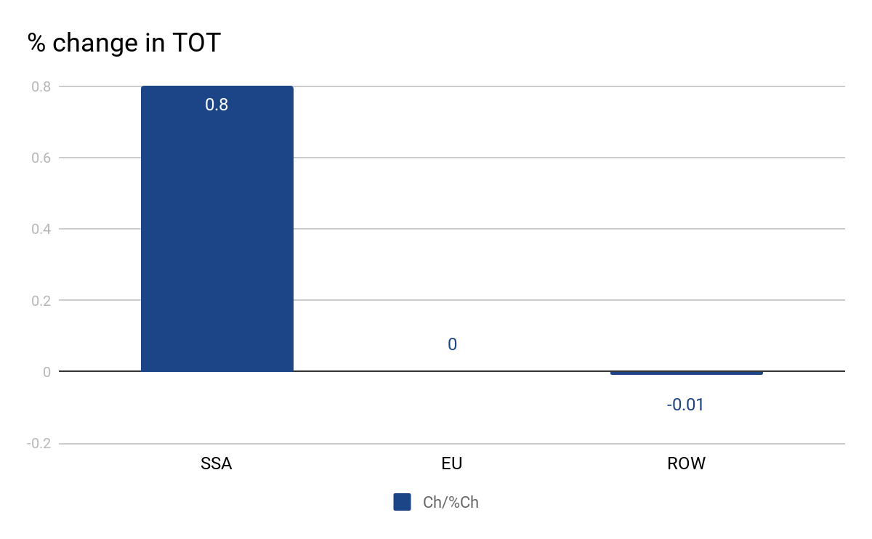
Effect on TOT
Tot | Pre | Post | %Ch
SSA | 1 | 1.008 | 0.8
EU | 1 | 1 | 0
ROW | 1 | 0.9999 | -0.01

Slide 23
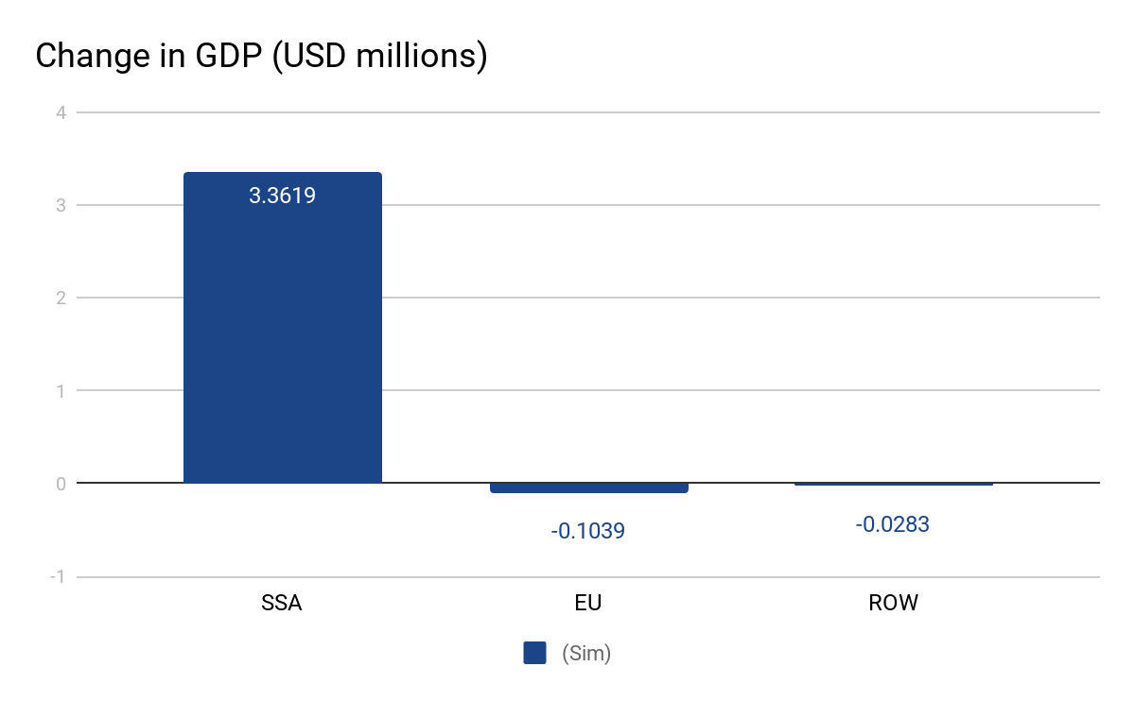
Change in GDP(USD millions)
vgdp | Change
SSA | 3.3619
EU | -0.1039
ROW | -0.0283
Increase in Export demand in SSA => increase in production => increase in employment => increase in GDP, Similar for EU
A good indicator of Allocative efficiency is GDP and we can see that allocative efficiency in SSA has increased

Slide 24
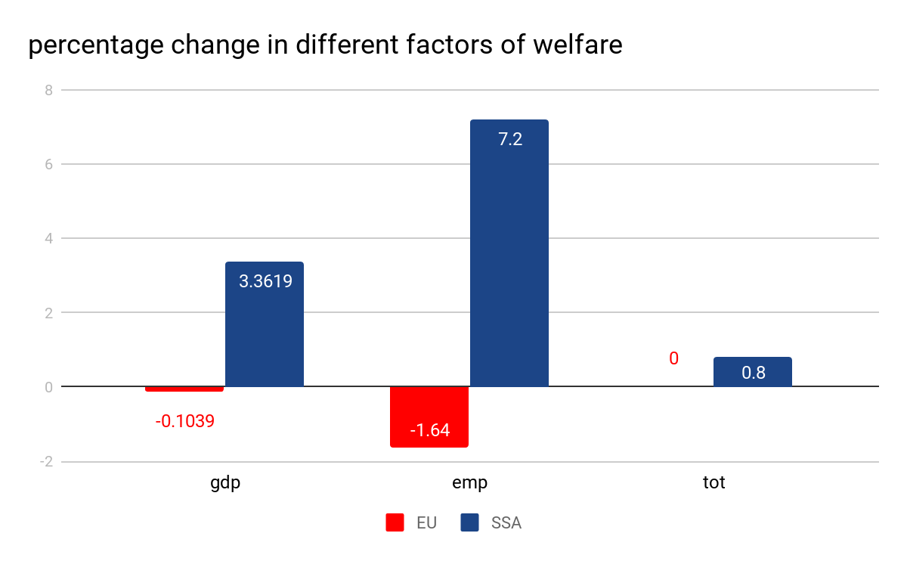
Welfare = f(gdp, tot, emp)
It is clear that the welfare of SSA has increased but the EU’s welfare has gone down
parameter | EU | SSA
gdp | -0.1039 | 3.3619
tot | 0 | .008
emp | -1.64 | 7.2

Slide 25
Conclusion
SSA will gain from FTA and EU will be loosing from FTA if we take emp, tot, gdp in context of welfare.

Slide 26
Sources
Nag, Biswajit and Sikdar, Chandrima, “Welfare Implication of India-ASEAN FTA: An Analysis Using GTAP Model (July 1, 2011)”, Indian Institute of Foreign Trade Working Paper No. EC-11-06.
Tsung-Chen Lee, Paul T.W. Lee, “South-South trade liberalisation and shipping geography: a case study on India, Brazil, and South Africa”, International Journal of Shipping and Transport Logistics, Volume 4, Issue 4
Ahmed, S.India-ASEAN Free Trade Agreement: A sectoral analysis, SSRN Working paper
1698849 (2010). Accessed November 2010. http://ssrn.com/abstract=1698849
Dash, P. K. (2010).‘India-ASEAN: Trade in goods agreement’,SME Times, 20 January 2010.New Delhi, India.
Huff, K. M. and T. W. Hertel (2000). “Decomposing welfare changes in the GTAP Model” , GTAP Technical Paper No. 5. Centre for Global Trade Analysis, Department of Agricultural Economics, Purdue University, Indiana, United States.

Slide 27
https://www.gtap.agecon.purdue.edu/resources/res_display.asp?RecordID=1638 - documentation
https://www.gtap.agecon.purdue.edu/resources/download/86.pdf - hertel
https://jgea.org/resources/jgea/ojs/index.php/jgea/article/view/47 - journal of economic analysis
https://www.gtap.agecon.purdue.edu/resources/download/185.pdf - welfare decomposition - important paper
https://www.gtap.agecon.purdue.edu/resources/download/2365.pdf - decomposition welfare changes

Slide 28
Thank you

